Slide 1
Web fundamentals
Gomycode training
Checkpoint 1
Nabil Messaoud

Slide 2
Web definition
The Web works on the top of the internet
Is a system that interacts resources via hyperlinks
We need a browser to access it : IE, google chrome, Mozilla Firefox
Resources are presented on web pages and websites via URL

Slide 3
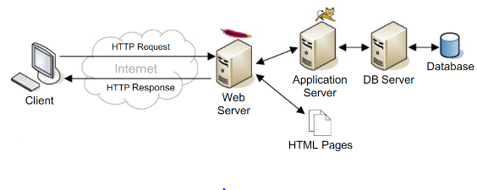
Web architecture
It’s a communication between two systems: clients and server via the internet
We use HTTP as a communication protocol to manipulate data on the server: retrieve, add, update or delete

Slide 4
Data transmission
Each system the clients and the server is identified by IP address
The transmission between these systems is ruled by two protocols TCP/IP
The methods used in HTTP protocol are regrouped in a software called API

Slide 5
Web development requirments
The web development covers three layers :
Client-side coding (front-end):HTML, CSS and javascript, jQuery, React, Angular, or Vue
Server-side coding (back-end): PHP, ASP, Python, or Node
Database technology: SQL, MangoDB, SQLite

Slide 6
Web developer Role:
Create or modify existing website using HTML and CSS to have beautiful design and javascript to create and add functionalities.
He also works on the back end the server and database which are not visible to the user
Characteristics of a Successful Web Developer
A passion for knowledge, Great teammate, Creative problem solver, Ability to plan for everything, Great debugging skills

